Slide 1
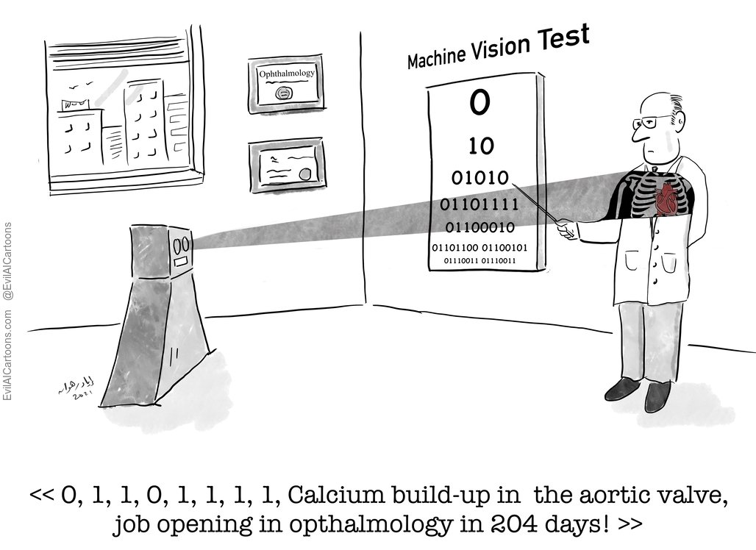
The Impact of AI on Job Automation and Future Workforce
Amit S Terdal
Shreyansh Patel
Preetham Reddy Matta
Kodanda Harshavardhan Alla
Rahul Jakkampoodi
Kevin Moses Kothapalli

Slide 2
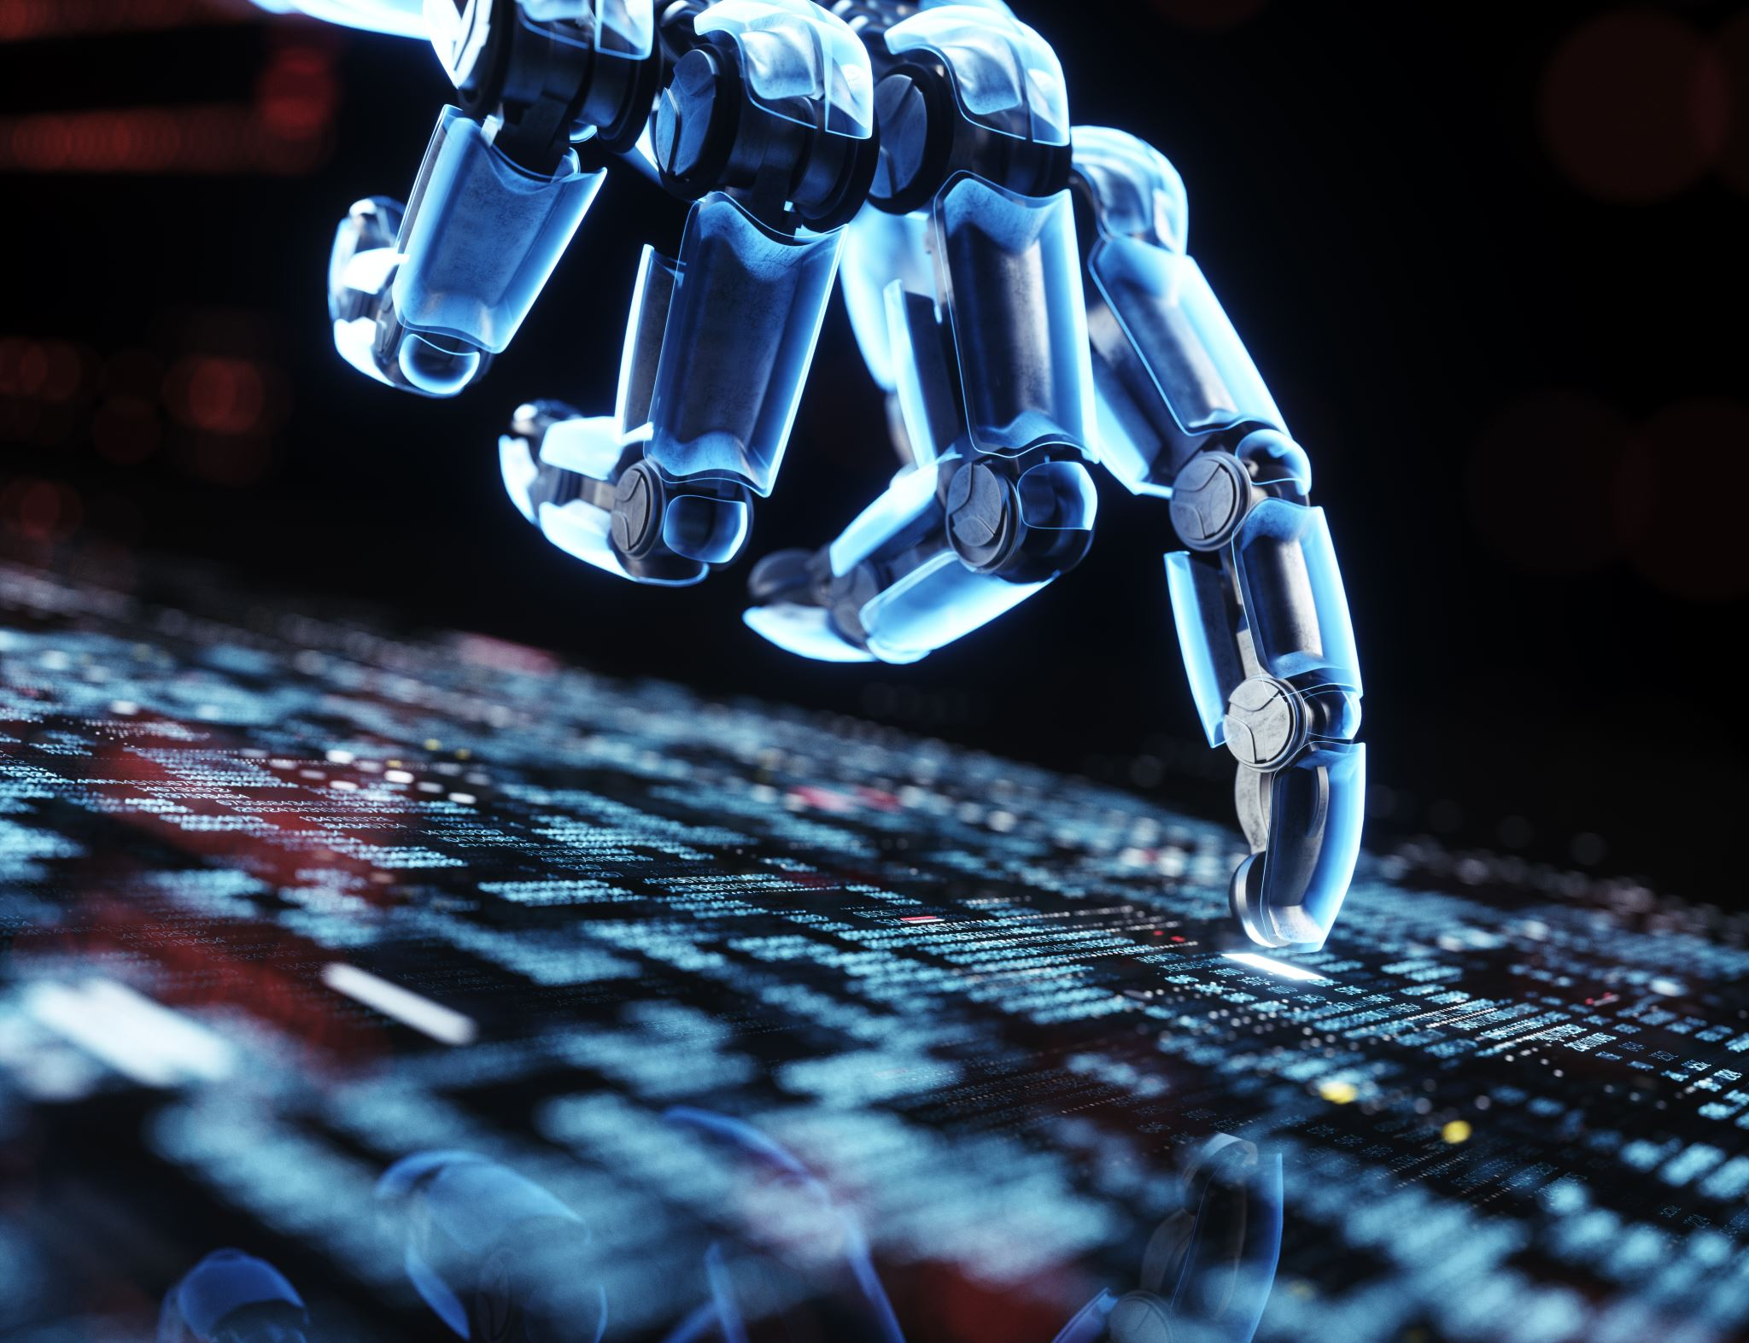
What is AI and Job Automation?
AI: Artificial Intelligence refers to machines designed to perform tasks that typically require human intelligence.
Job Automation: The use of technology to perform tasks with minimal human intervention.
AI-powered chatbots, self-driving cars, and automated manufacturing systems.

Slide 3
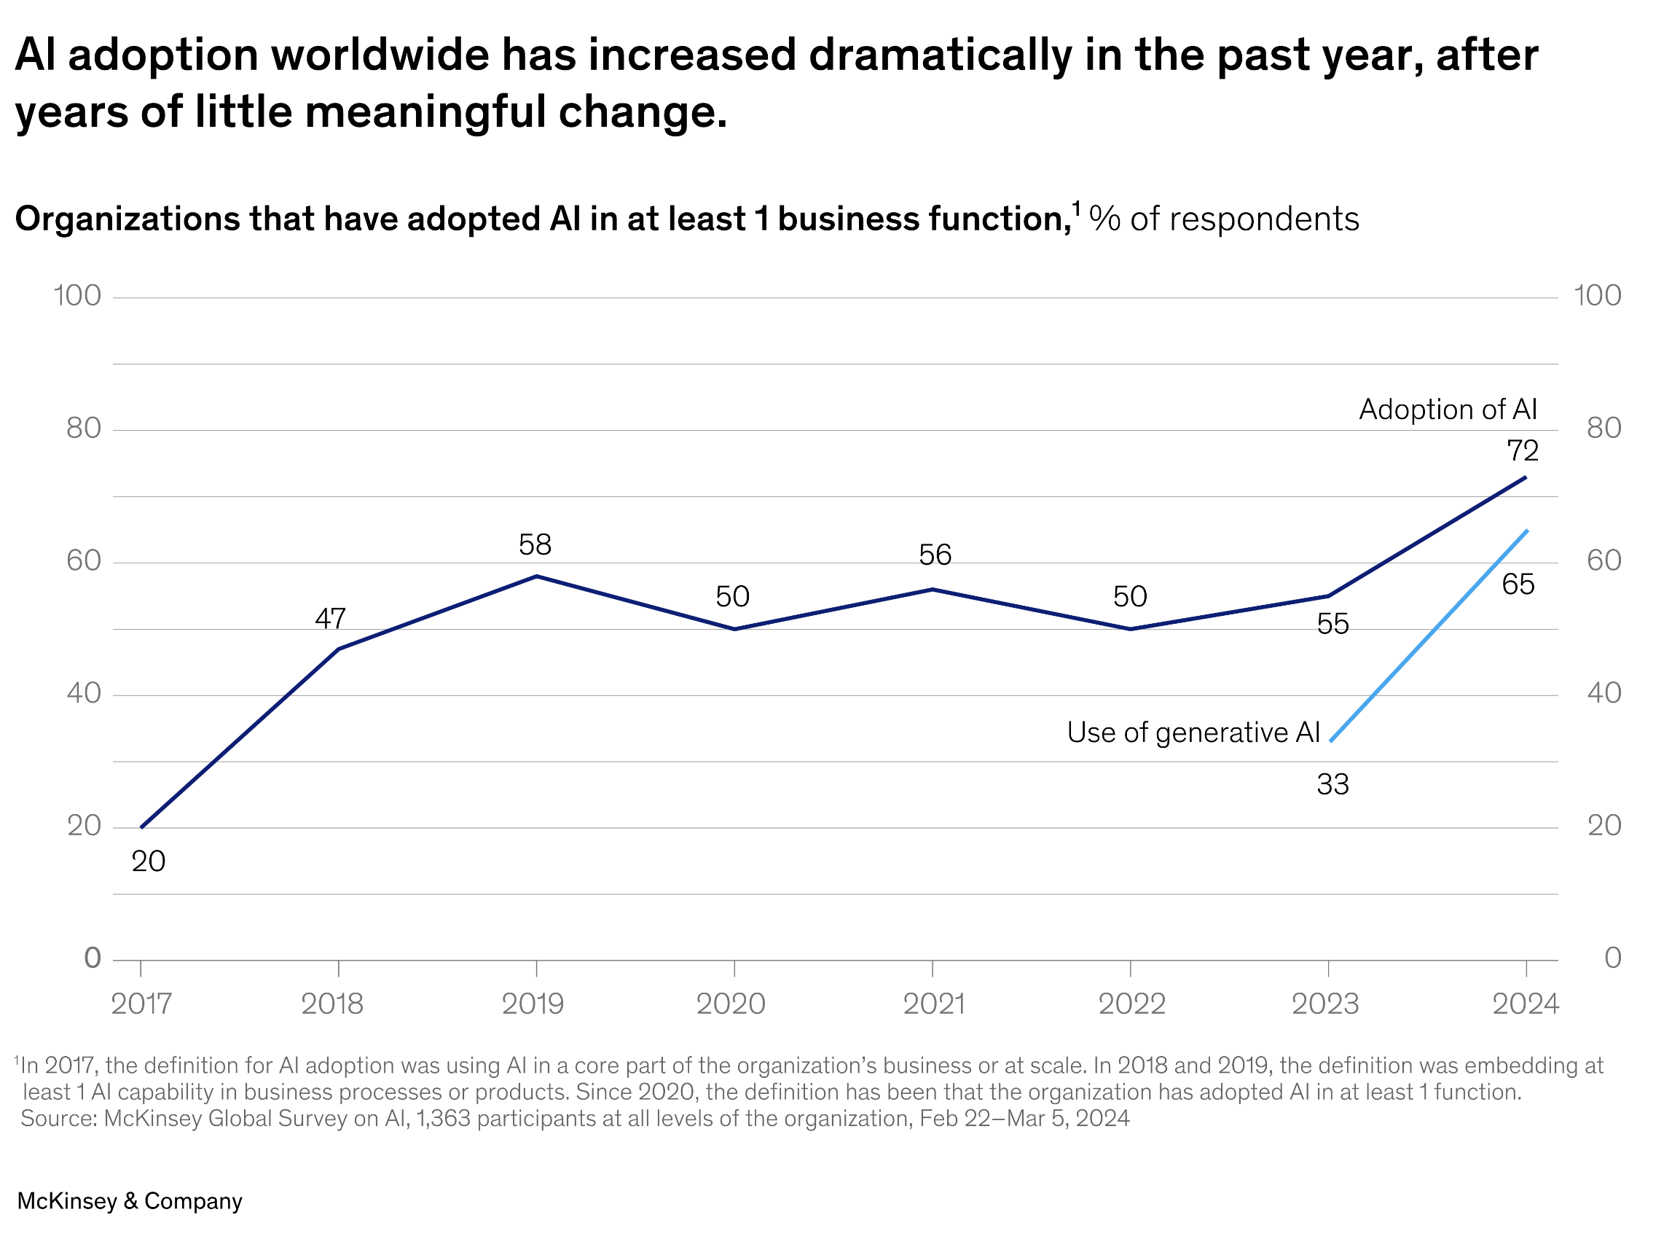
Why is this topic important?
Rapid advancements in AI are transforming industries.
By 2030, up to 30% of jobs could be automated.
Impacts on employment, economy, and society.

Slide 4
Key questions to explore
How is AI currently being used in job automation?
Which jobs are at risk, and which new jobs will emerge?
What skills will be needed in the future workforce?
What are the ethical and social implications of AI-driven automation?

Slide 5
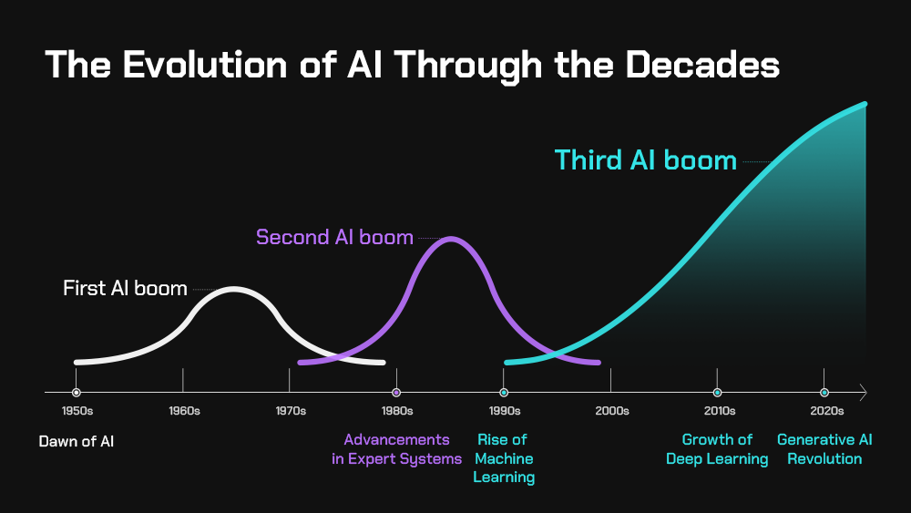
Automation Growth
Timeline of AI advancements (1950s: First AI programs to 2020s: Generative AI).

Slide 6
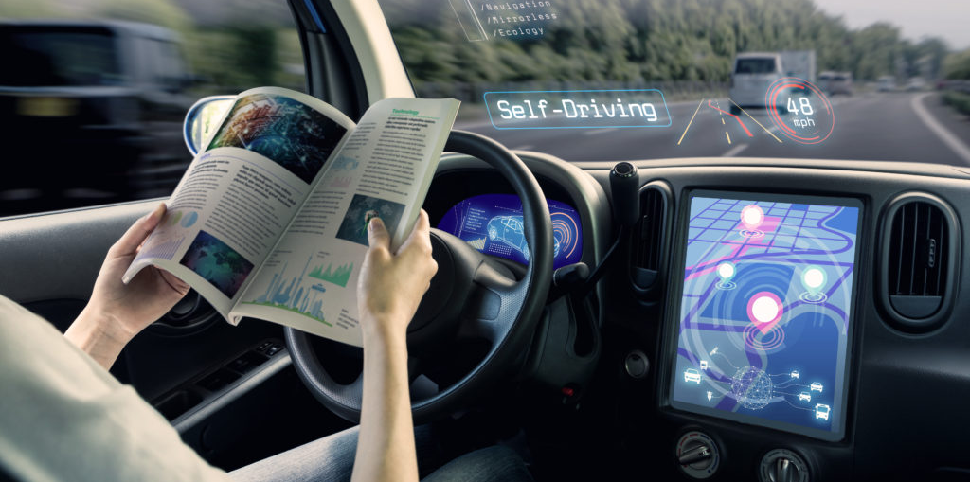


Examples of AI in Industries
Healthcare: AI diagnostics, robotic surgery.
Manufacturing: Automated assembly lines.
Retail: Self-checkout systems, inventory management.
Transportation: Self-driving vehicles

Slide 7
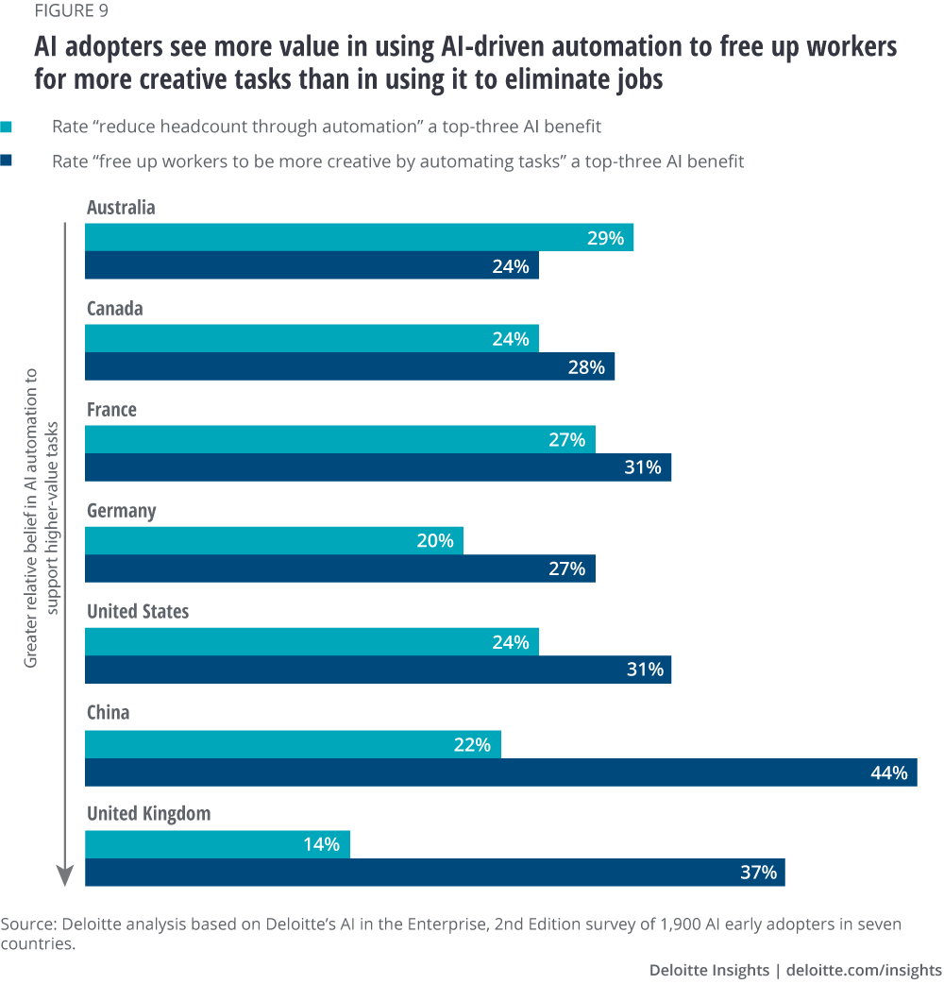
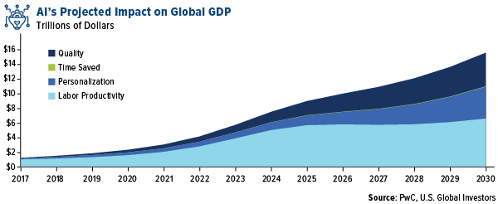
Statistics on Automation Trends
47% of U.S. jobs are at risk of automation.
AI could contribute $15 trillion to the global economy by 2030.

Slide 8
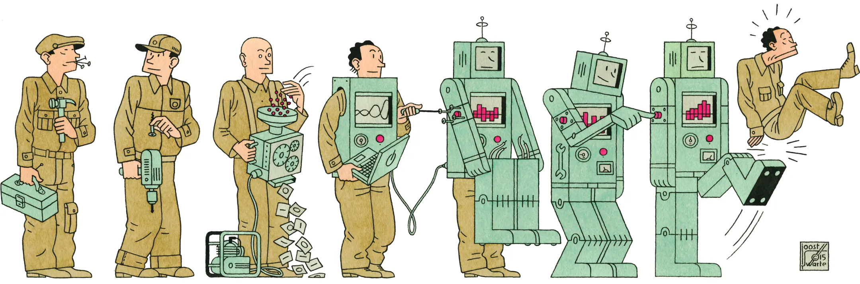
Jobs at Risk of Automation
Repetitive, routine tasks are most vulnerable.
Examples: Data entry, cashiers, factory workers.
60% of occupations have at least 30% automatable tasks (McKinsey report).

Slide 9
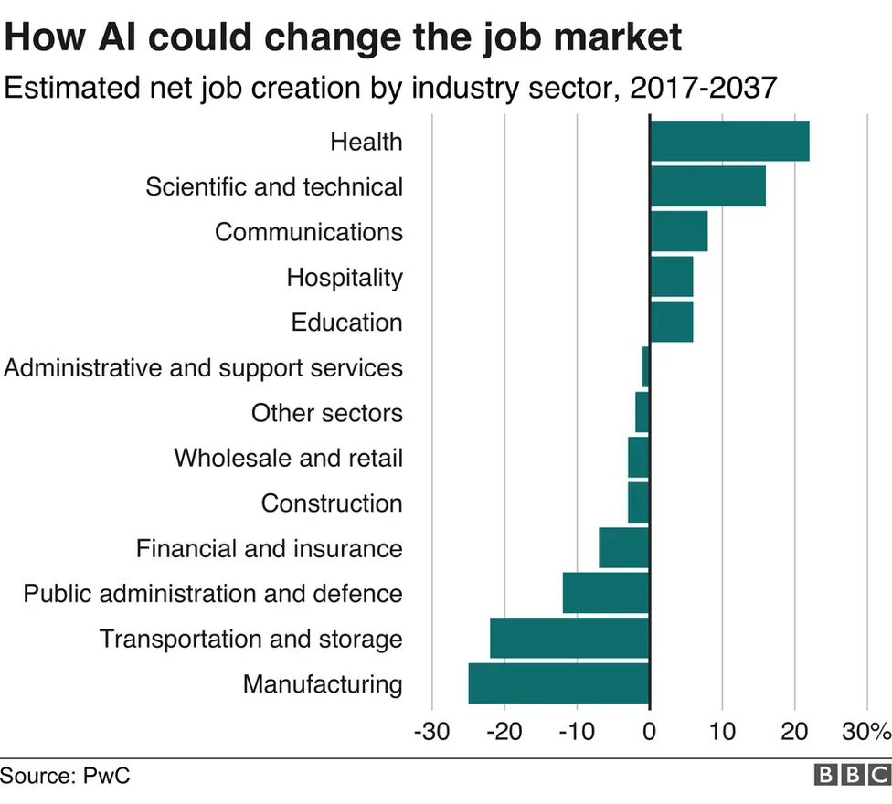
Jobs created by AI
New roles: AI trainers, data scientists, robotics engineers.
Emerging industries: AI ethics, cybersecurity, green energy.
"AI could create 97 million new jobs by this year".

Slide 10
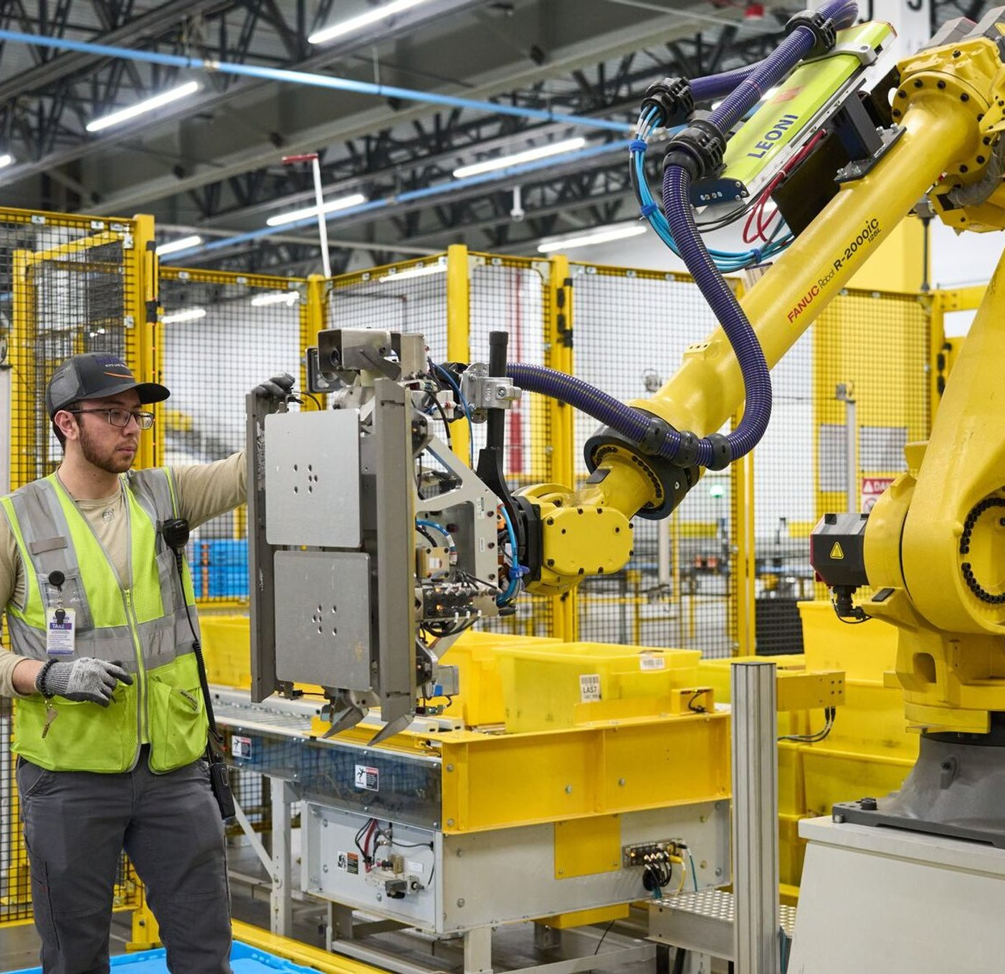
A Case Study
Amazon uses AI for warehouse automation but also created thousands of tech jobs to maintain these systems.
Discuss both sides: job losses in manual labor vs. gains in tech roles.

Slide 11

Key Skills Needed
Technical skills: Data analysis, programming, AI literacy.
Soft skills: Creativity, critical thinking, emotional intelligence.
Adaptability and lifelong learning.

Slide 12

Importance of Reskilling
“54% of employees will require significant reskilling by 2025” (World Economic Forum)
Examples of reskilling programs: Online courses, corporate training.

Slide 13
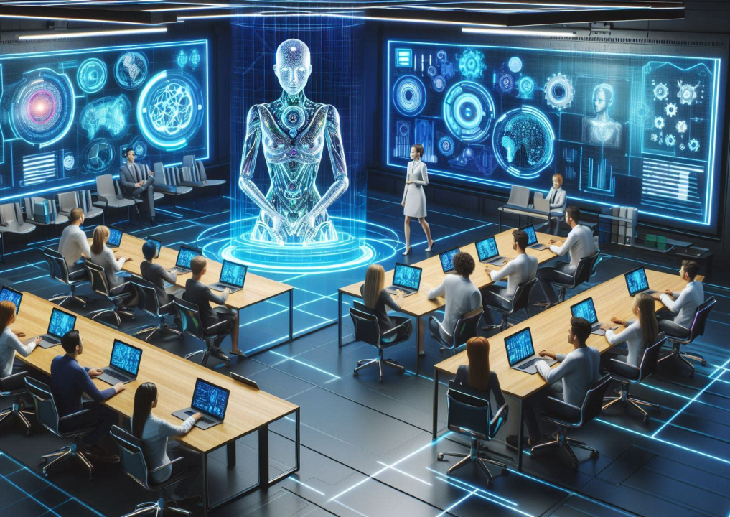
Revolution in Training Programs
Google’s Career Certificates.
IBM’s SkillsBuild.
Government initiatives (e.g., Singapore’s SkillsFuture).

Slide 14
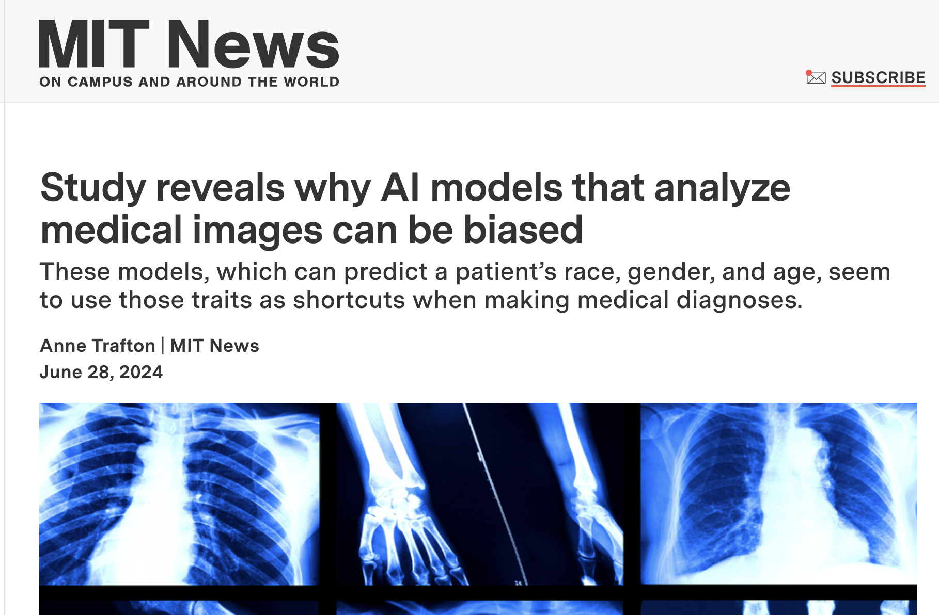
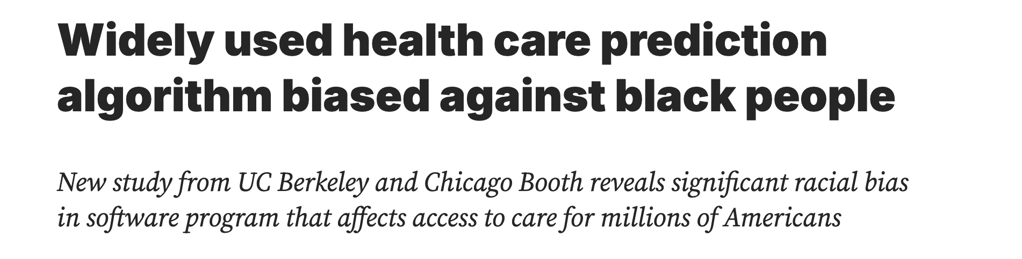
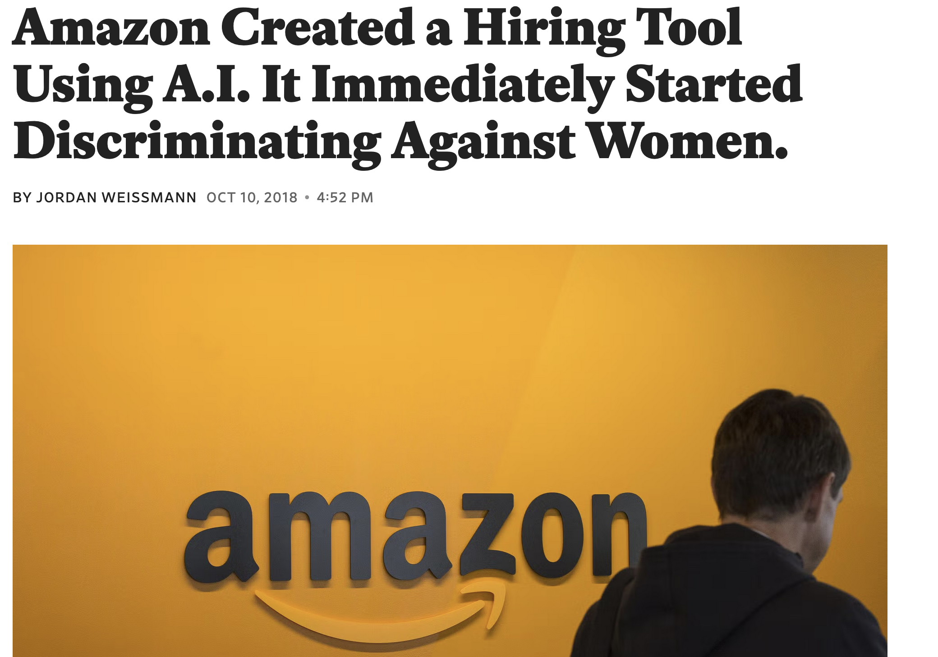
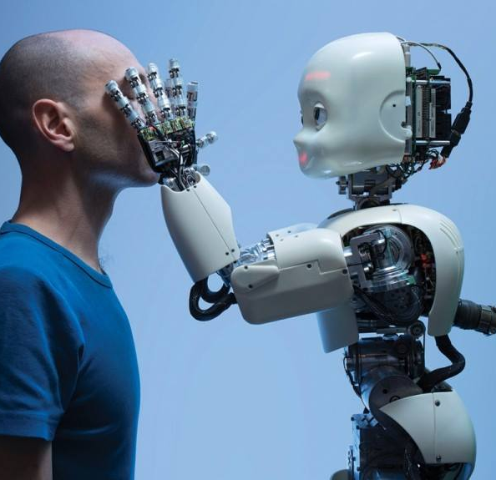
Ethical Concerns
Bias in AI algorithms (e.g., hiring algorithms favoring certain demographics).
Privacy issues (e.g., data collection by AI systems).
Accountability: Who is responsible for AI decisions?
Visual: Icon-based list or a news headline about AI bias.

Slide 15
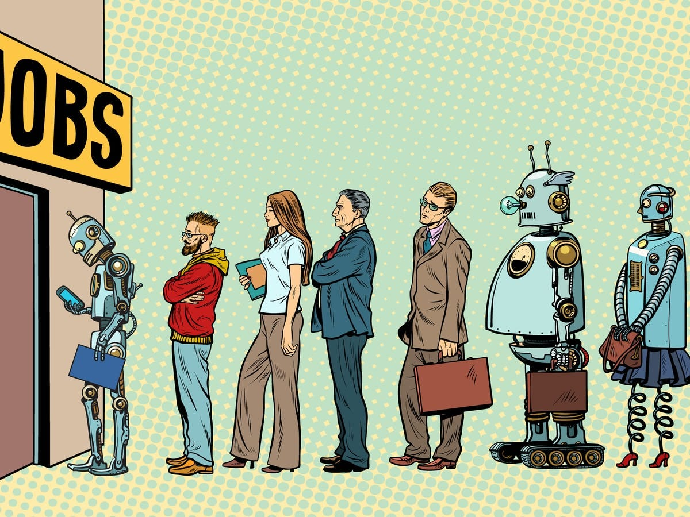
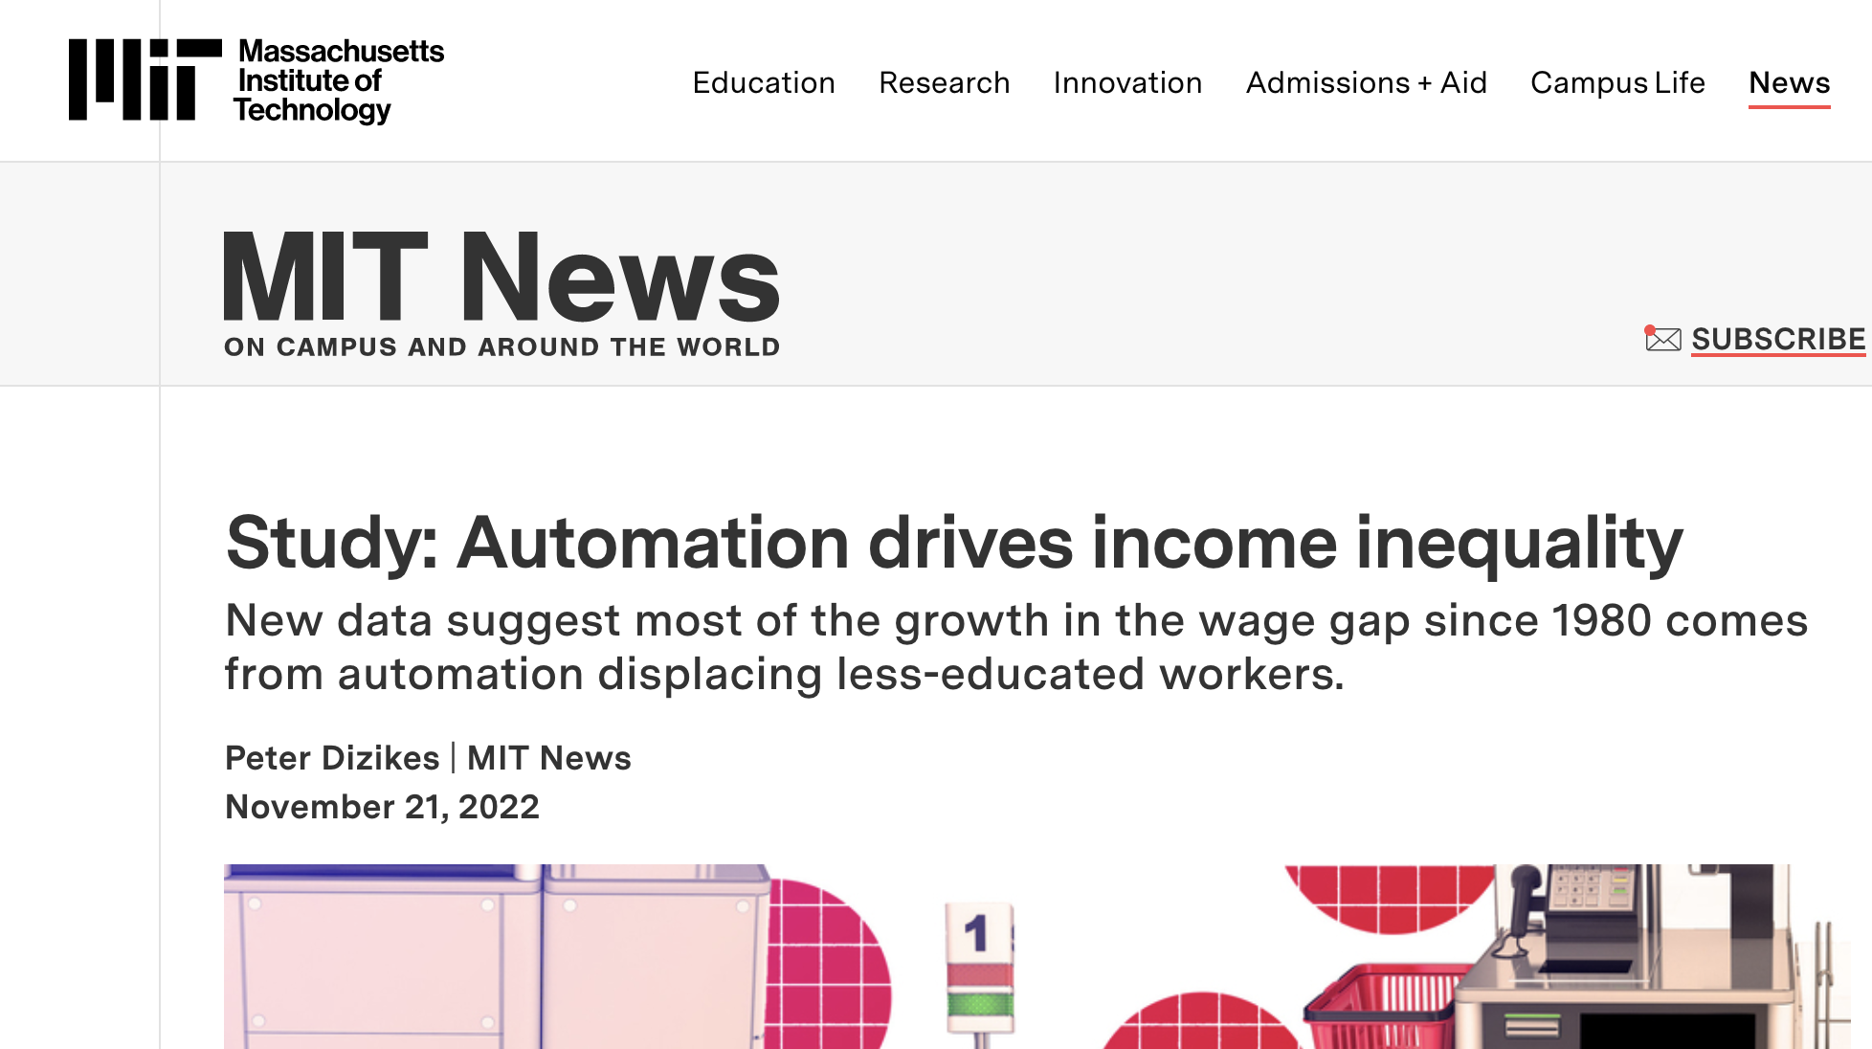
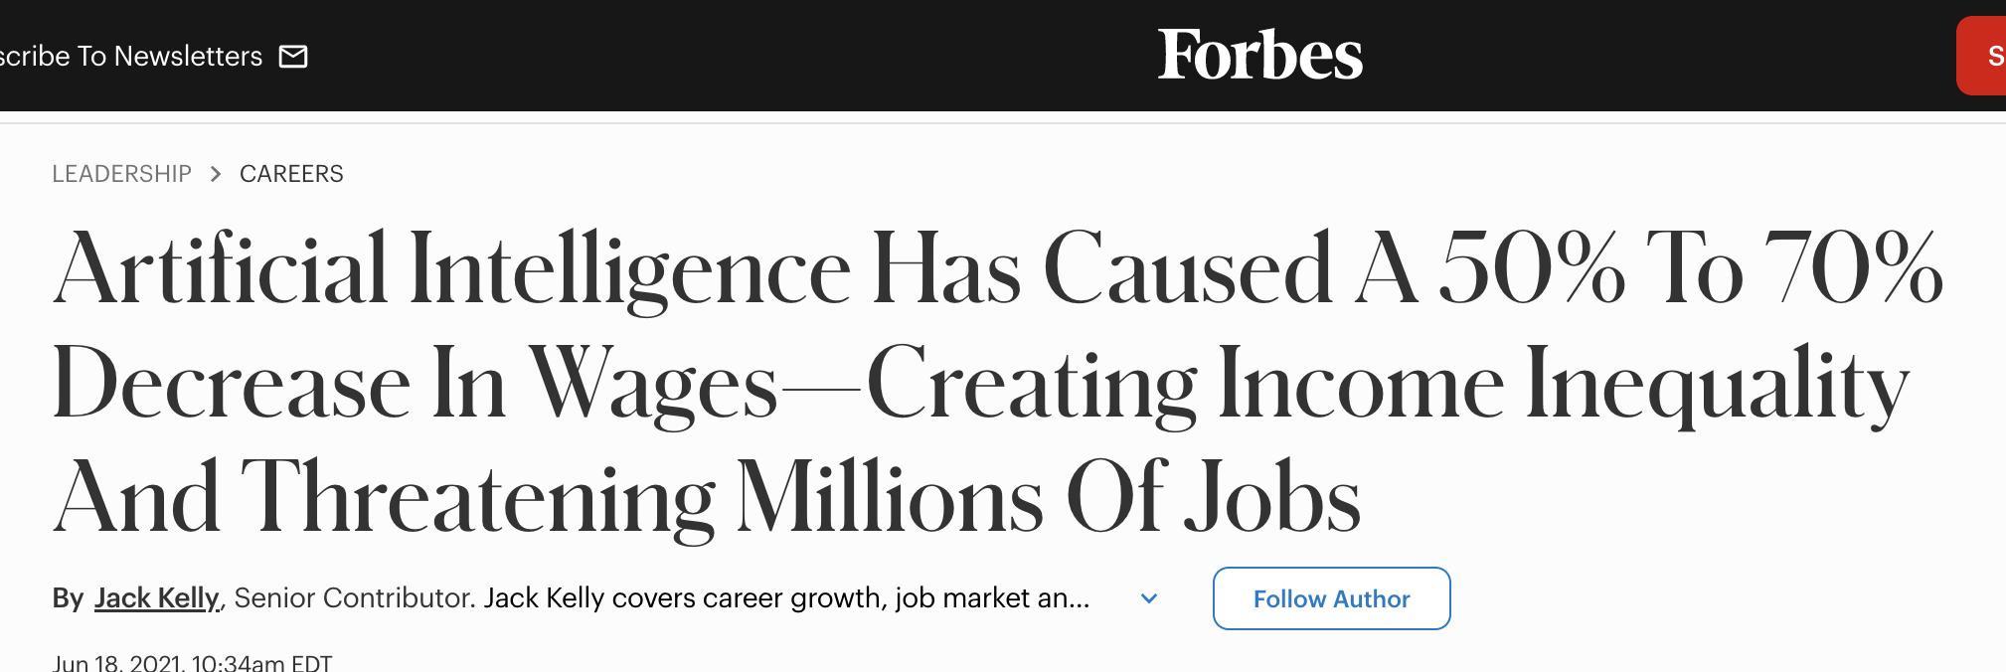
Social Impact
Job polarization: High-skilled vs. low-skilled workers.
Income inequality: Wealth gap between tech elites and others.
Potential for mass unemployment.

Slide 16
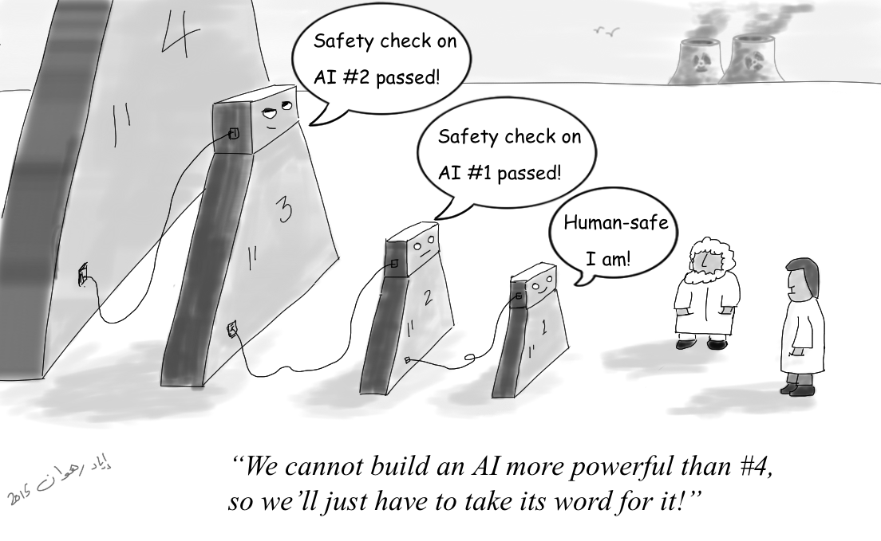
Potential Solutions
Policy changes: Universal Basic Income (UBI), AI regulation.
Ethical AI frameworks: Transparency, fairness, accountability.
Corporate responsibility: Investing in employee reskilling.

Slide 17
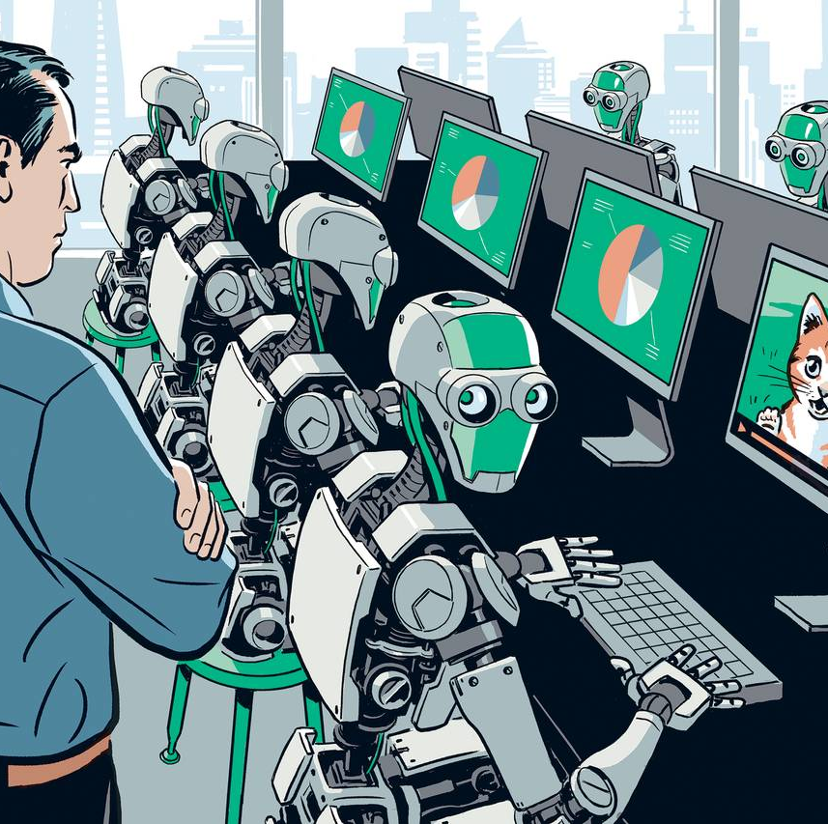
Summary of Key Points
AI is transforming jobs and industries.
While some jobs are at risk, new opportunities are emerging.
Reskilling and adaptability are crucial for the future workforce.
Ethical and social challenges must be addressed.

Slide 18

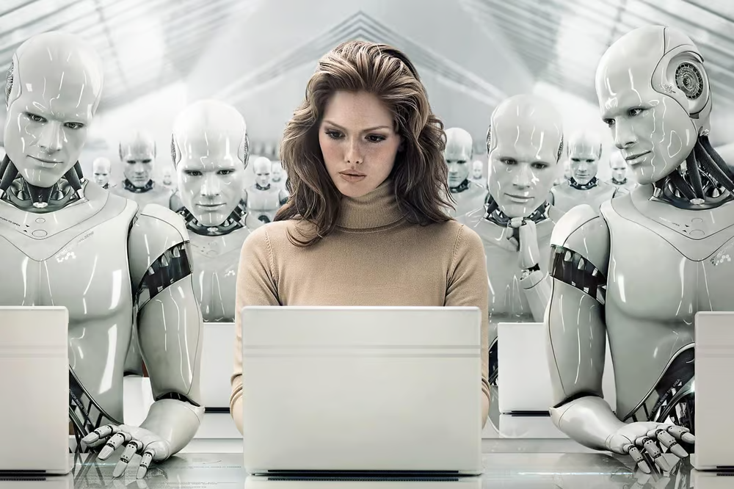
So, what does the future look like?
Not just a tech shift. A tipping point. The real question.
Increased collaboration between humans and AI.
A long way from the WHEEL.
Closing thoughts.

Slide 19
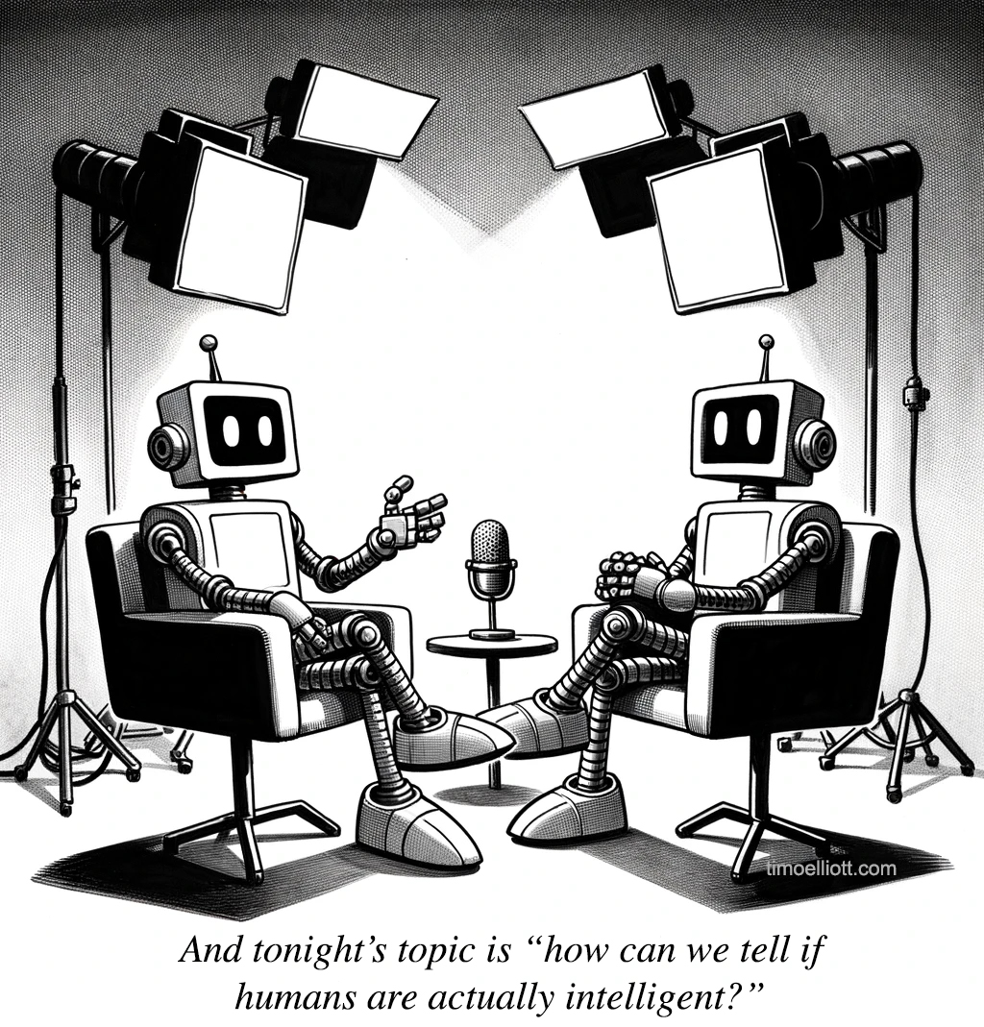
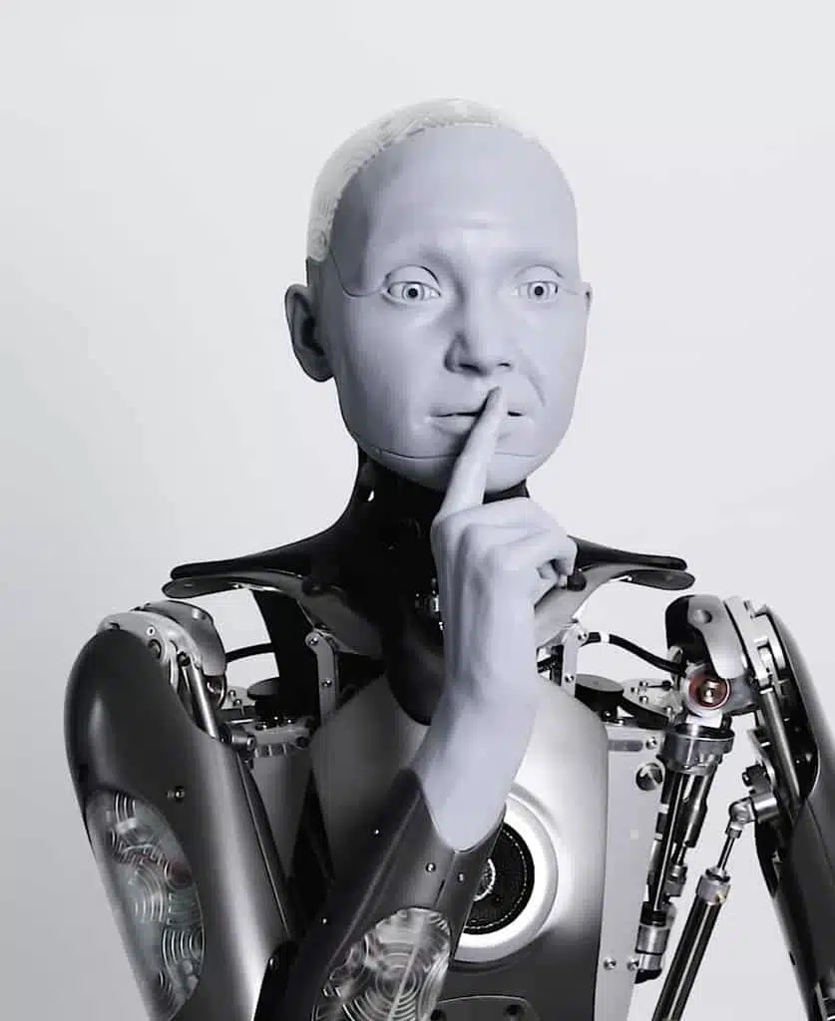
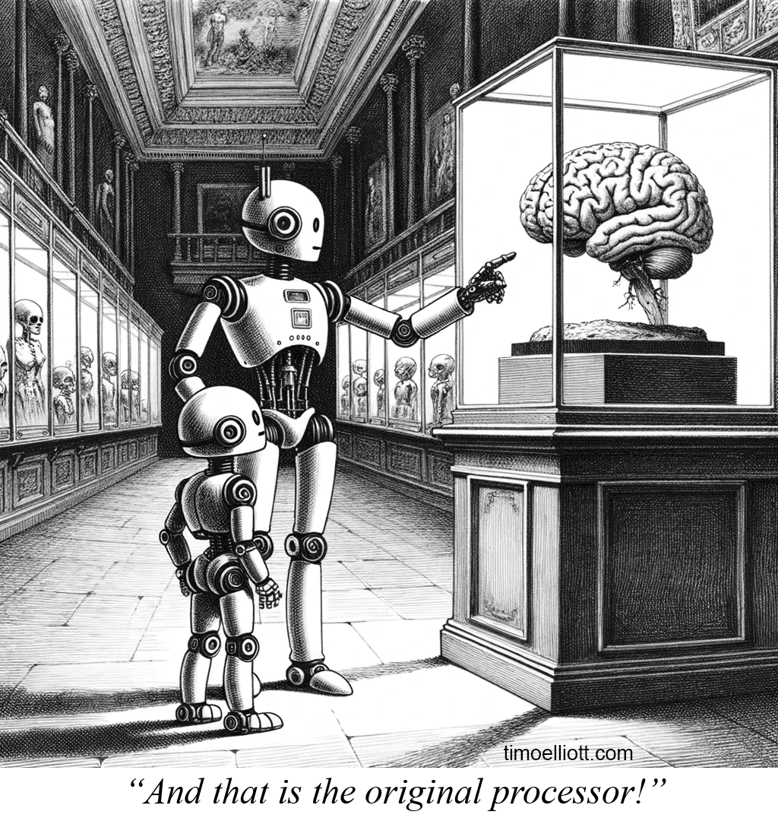
Questions?

Slide 20
Thank You

